Slide 1


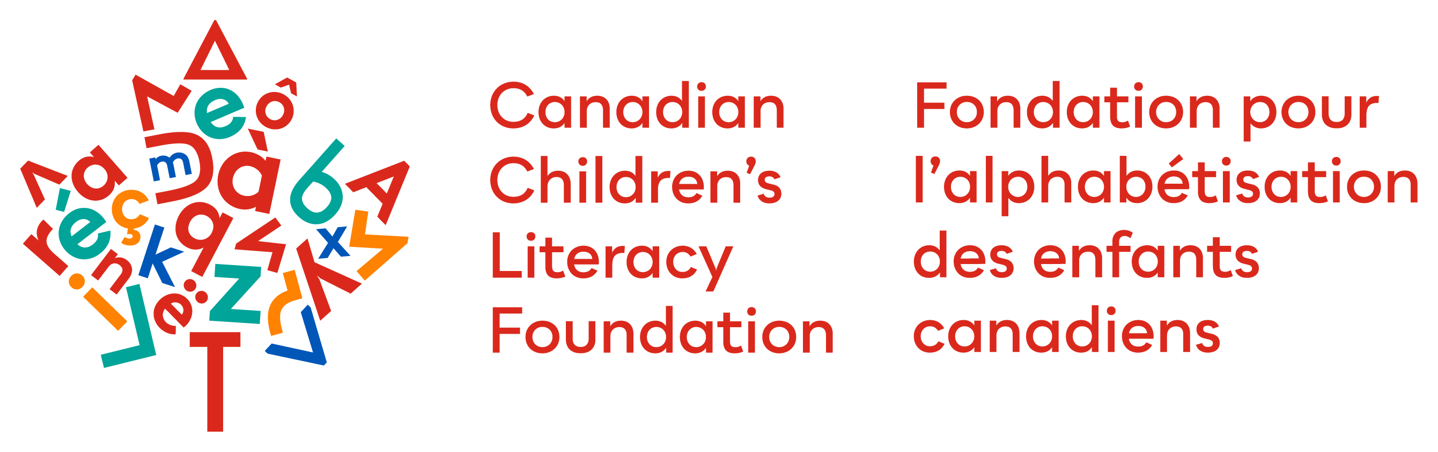
Literacy as a Vital Sign
Pre-Clerkship Level Guide
The Literacy Prescription:
A Medical Student’s Guide to Early Literacy
[Presenter name and credentials]
[Institution or organization]
Notes:
Early literacy is sometimes perceived as an educational issue that begins when a child enters school. In reality, the foundations for language, communication, relationships, and later reading begin in infancy.
Healthcare practitioners have repeated opportunities to support these foundations before children enter school. We can introduce early literacy during routine care, model practical activities, identify concerns, support families facing barriers, and connect families with appropriate resources.
Frame literacy not as an educational milestone or a "lifestyle choice," but as a biological metric of pediatric development..
Task the students today with reframing their future role. They are not just treating organic pathology; they are actively protecting neural architecture and downstream health of individuals.

Slide 2
Faculty Disclosure
Faculty disclosure
Presenter: [Name]
Relationships with commercial interests: [Insert]
Financial or in-kind support: [Insert]
Mitigation of potential bias: [Insert]
This presentation includes discussion of publicly available literacy resources.
2
Notes:
Complete according to the accrediting organization’s CME requirements.

Slide 3

Session Objectives
1
Describe the neurobiology of early language and literacy development.
2
Explain how early literacy influences long-term health and education outcomes.
3
Identify the role healthcare providers can play in supporting early literacy.
3
Notes:
Emphasize that participants are not expected to become reading specialists.
The clinical role is to:
Understand how early language develops in the infant’s brain.
Understand how literacy is linked to greater health and education outcomes.
Recognize simple opportunities to promote literacy in clinical interaction.

Slide 4
Thé l%tt#$ k%tt&n s*t on th# r$g. It s_w a b_g b_g fl_ n##r th# d##r. "M##w!" s**d th# k%tt&n. Th# fl_ fl#w w_y h%gh %nto th# sk. Th# l%tt#$ k%tt&n curl#d _p @nd w&nt to sl##p.
4
Notes:
The Task: Ask a medical student to read the slide aloud to the room. Give them 15–20 seconds to struggle, stutter, and attempt to sound it out under pressure.
Reveal the decoded text: The little kitten sat on the rug. It saw a big bug fly near the door. "Meow!" said the kitten. The fly flew away high into the sky. The little kitten curled up and went to sleep.
This frustration and confusion are what a child with an unaddressed decoding deficit or dyslexia experiences every single day at school. When a child faces this barrier, reading isn't fun; it is an exhausting source of chronic anxiety that quickly manifests as somatic complaints and school avoidance.
Consider this discussion prompt: "To the student who just read that: describe the physical sensation of trying to decode that paragraph under pressure. How did it feel?”
You want to help students realize that decoding failure is physically and emotionally exhausting. A child spending 90% of their metabolic brain energy simply trying to translate letters into sounds has little cognitive reserve left for actual comprehension.

Slide 5

Literacy begins before birth.
5
Notes:
90% of brain volume forms before age 5, driven by environmental stimuli. Drive home the timeline. Because 90% of brain volume forms before age 5, waiting until kindergarten to address literacy is a failed reactive strategy.
The 3rd-Grade Cliff: Third-grade reading proficiency predicts high school graduation rates with high accuracy. Explain the shift from learning to read (K-Grade 3) to reading to learn (Grade 4 onward). If a child cannot decode by Grade 3, the rest of the curriculum becomes inaccessible.
The Lifelong Health Trajectory: Emphasize that third-grade reading proficiency is a highly accurate, evidence-based predictor of adult health equity and medical compliance.

Slide 6
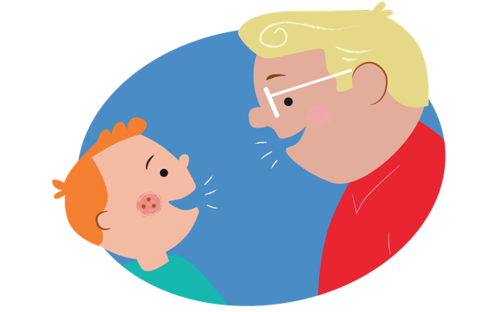
The Neurobiology of the Reading Brain
6

Slide 7
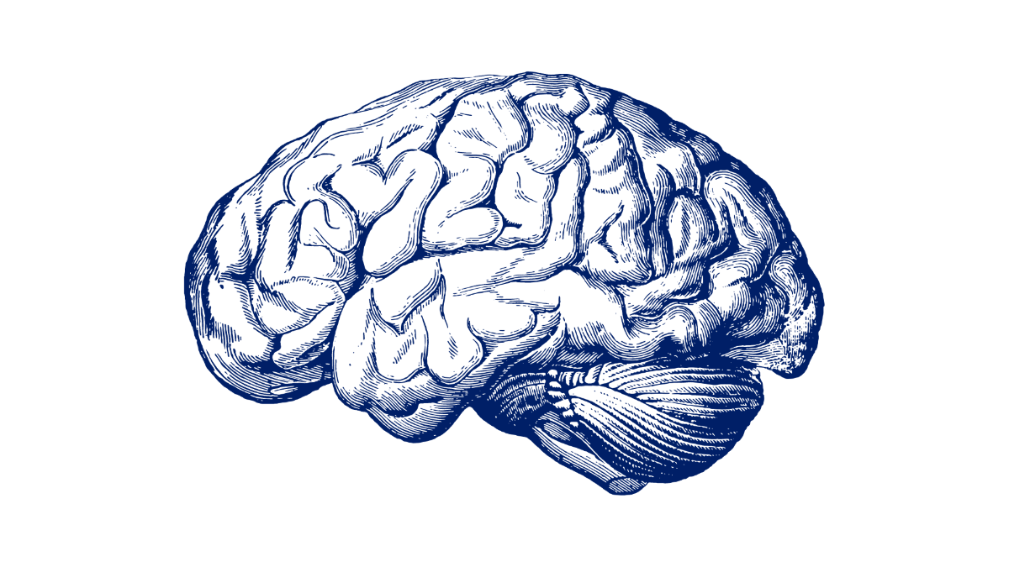
Speaking is hardwired; reading is not.
Parieto- temporal region
The Brain’s Letterbox = the Visual Word Form Area (VWFA) located in the left fusiform gyrus.
Auditory and visual signals travel along the arcuate fasciculus to connect phonological processing (Wernicke's area) with articulation and grammar (Broca's area).
Structural MRI shows increased white matter microstructures and myelination in children with high household book exposure.
Occipito- temporal region
Occipito- temporal region
Notes:
Emphasize that human evolution hardwired speech, but reading is an artificial, cultural invention. The brain has no native reading center; it must actively repurpose existing visual and auditory circuits.
The Brain's Letterbox (VWFA) is located in the left fusiform gyrus. Through literacy, this area is recycled to recognize abstract letter shapes instantly, turning visual inputs into language.
Highlight that environmental stimulation is a physical mutagen for white matter. Children with high book exposure show structural MRI evidence of increased myelination along the arcuate fasciculus, bridging Wernicke's and Broca's areas.
Consider asking this question to the group: "How would you explain to a parent, using neuroscience, that reading to their infant physically changes the structural wiring of their child's brain?"

Slide 8
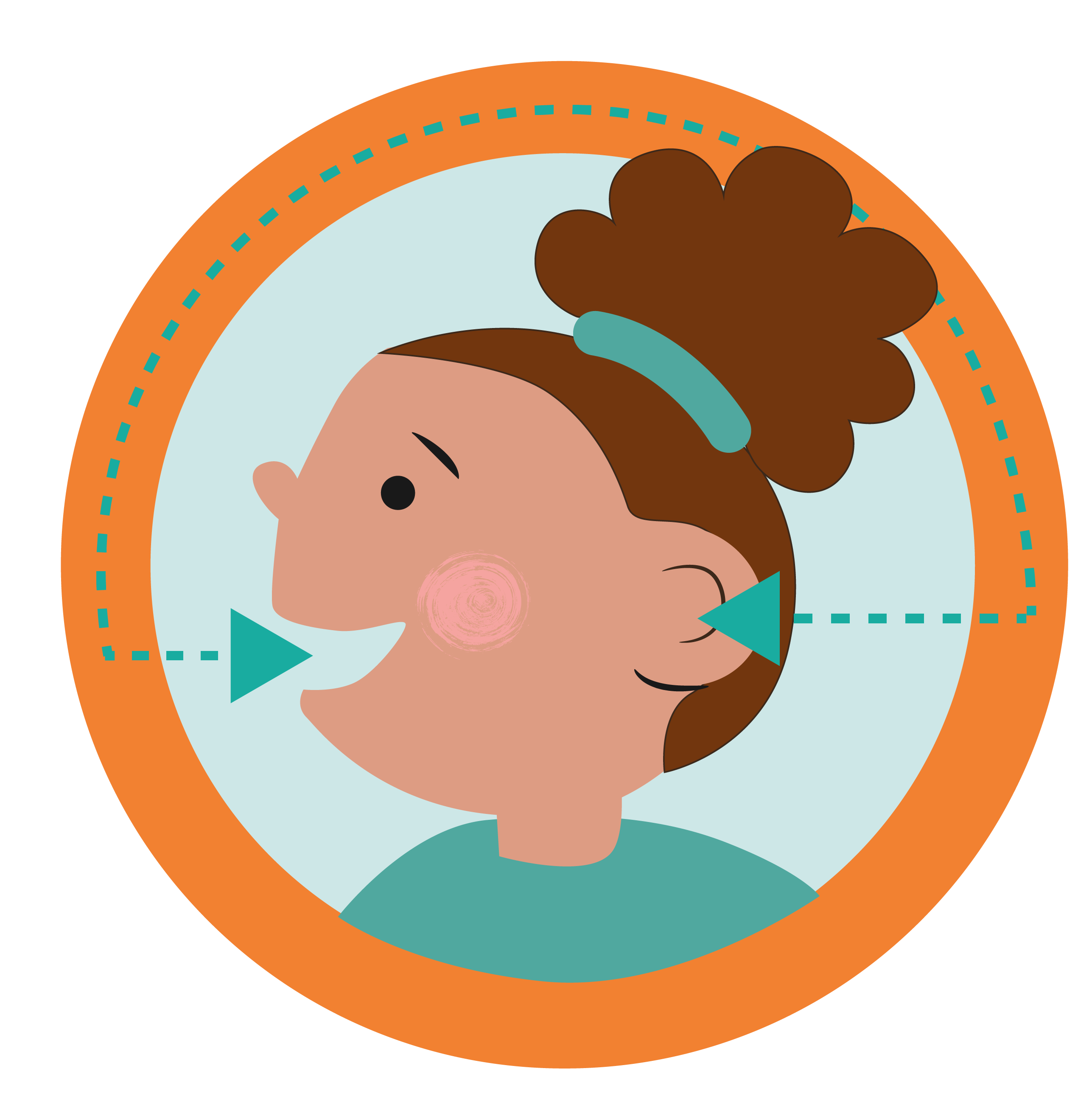
Dyslexia is a neurobiological learning difference characterized by atypical brain activation patterns during reading.
Disrupted connectivity in the left hemisphere, leading to increased activation in the right hemisphere.
Rewiring is possible!
Notes:
Clarify that dyslexia is a distinct neurobiological learning difference, not a deficit in intelligence, effort, or vision. It is characterized by atypical neural architecture and functional under-activation.
Neuroimaging shows disrupted connectivity in the brain's left-hemisphere reading network, particularly under-activation in posterior regions like the temporoparietal cortex and the VWFA.
Emphasize that fMRIs show a distinct lack of activation in the left temporoparietal cortex and the VWFA. The "fast track" for automatic word recognition is structurally disrupted.
To circumvent these left-hemisphere deficits, individuals with dyslexia often show increased activation in the right hemisphere and the left frontal lobe (e.g., Broca’s area).
Explain that individuals with dyslexia must resort to slow, exhausting compensatory pathways, using the right hemisphere and Broca's area to clumsily "muscle through" decoding.
Because the brain is highly plastic, evidence-based, structured literacy interventions can physically rewire these networks, strengthening neural pathways and improving reading fluency.

Slide 9

Language Development through Interaction
9

Slide 10
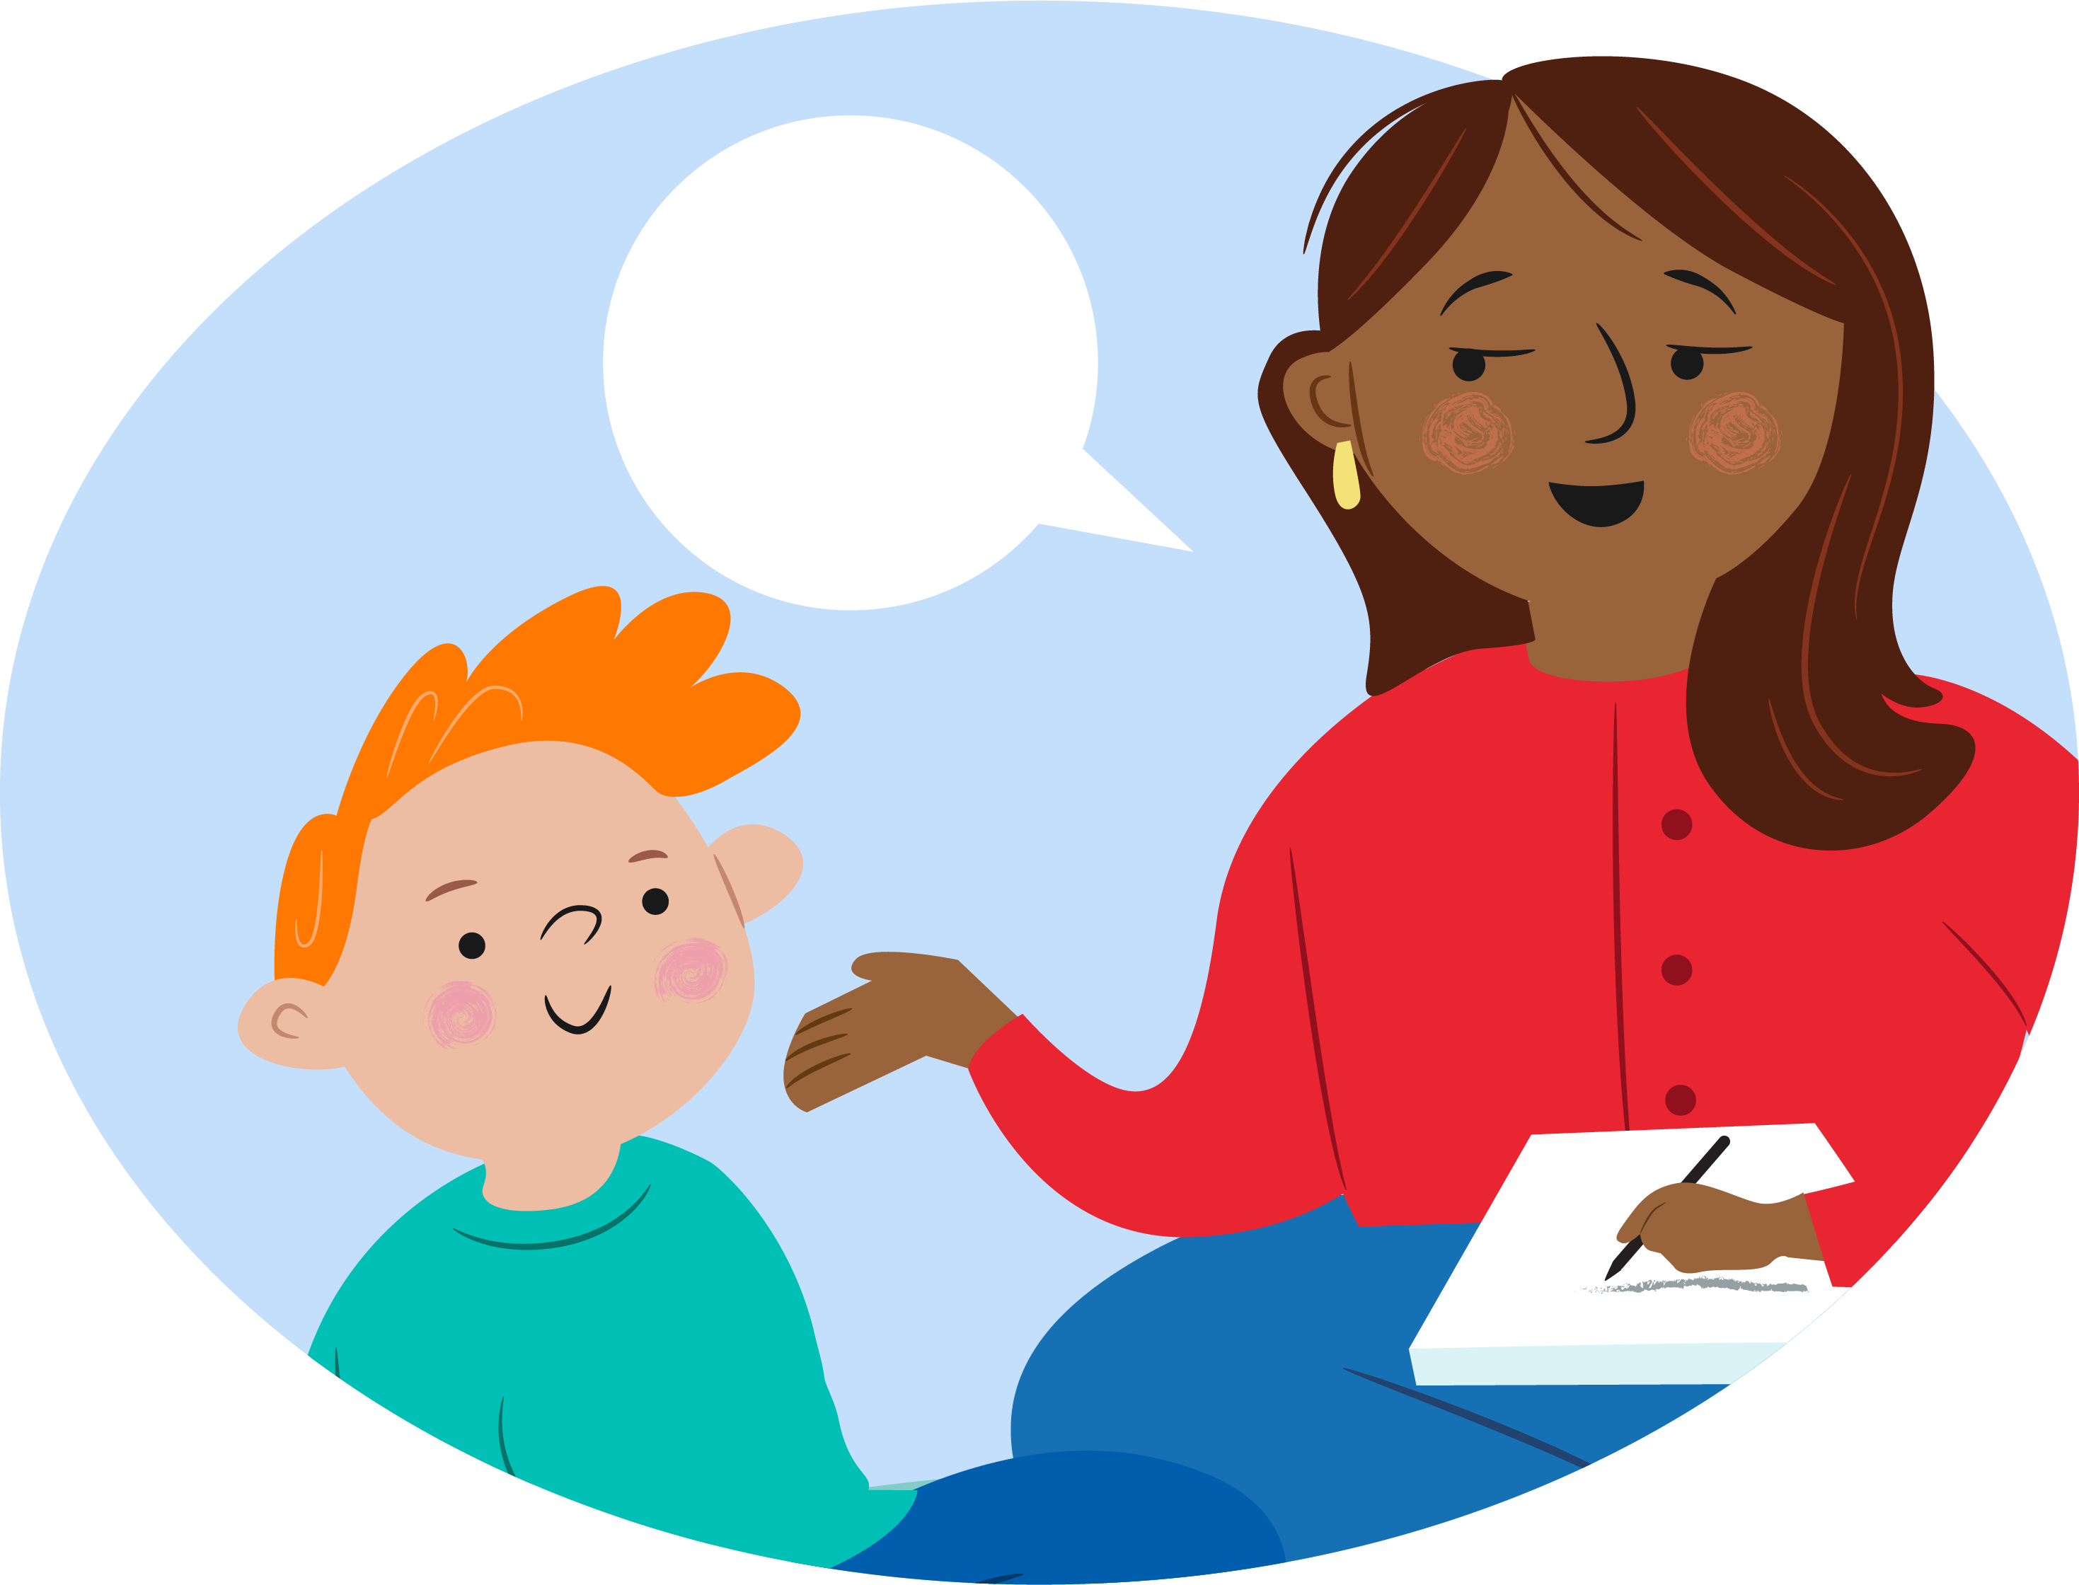
Young children learn language through responsive interaction.
The child looks, gestures, vocalizes, or speaks.
The adult notices and responds.
The child receives language connected to their attention.
The interaction continues.
These repeated exchanges build:
Communication
Vocabulary
Attention
Social connection
Emotional regulation
Foundations for later learning
10
Notes:
This is often described as “serve-and-return.”
The child initiates a “serve” through a sound, look, gesture, or word. A responsive adult “returns” the interaction by noticing, naming, imitating, expanding, or responding.
Books are useful because they create frequent opportunities for:
Joint attention.
Pointing.
Naming.
Turn-taking.
Prediction.
Emotional connection.
Repetition.
However, books are not the only way to create these exchanges. Songs, family stories, daily conversation, rhymes, and oral traditions are also valuable. These must be included when assessing literacy exposure in a household.

Slide 11

The goal is not finishing the book.
The goal is the interaction.
Shared reading can include:
Looking at one picture
Naming what the child notices
Asking and answering questions
Making sounds
Connecting the story to the child’s life
Letting the child turn pages
Repeating a favourite book
Stopping when the child is finished
11
Notes:
Many caregivers believe they are “doing it wrong” if the child does not sit quietly or if they cannot finish every page.
Clarify that developmentally appropriate shared reading is flexible and interactive.
An infant may chew a board book. A toddler may turn several pages at once. A preschooler may interrupt repeatedly or tell a different story from the pictures. These behaviours can all be part of healthy engagement.
The clinician’s job is to help caregivers recognize and enjoy what the child can do now.

Slide 12

Reading is a relational buffer.
Chronic poverty and lack of stimulation induce toxic stress, damaging hippocampal development.
The act of a caregiver holding a child and reading lowers cortisol and builds emotional resilience.
12
Notes:
Reframe the act of a parent holding a child and reading a book. This is not just an academic exercise; it is an active down-regulator of the neuroendocrine stress axis. It is a biological buffer that neutralizes toxic stress via relational health.
Consider posing these prompts to the group: "Think of a book as a medical device. How does a regular shared-reading routine physically shield a child's neuroendocrine system from toxic stress?”

Slide 13
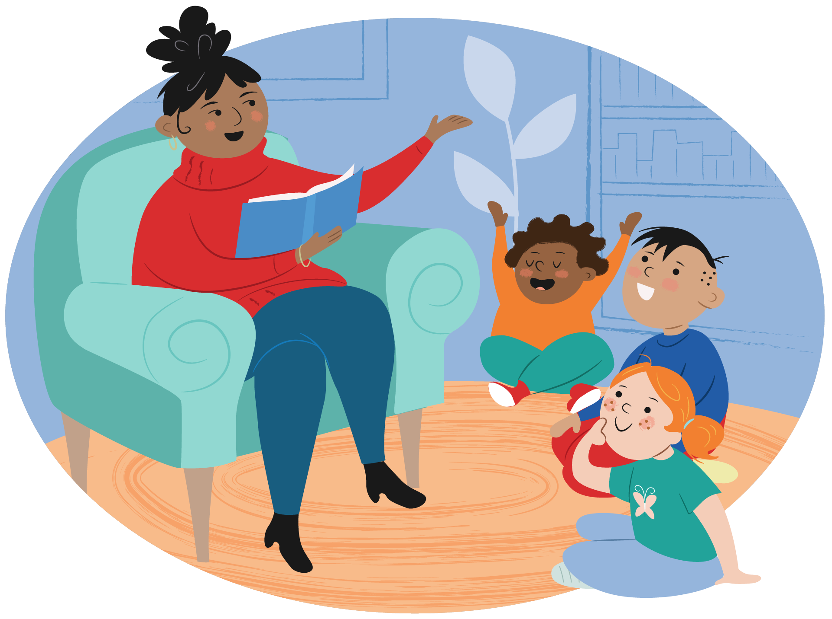
Literacy as a Social Determinant of Health
13

Slide 14
Early literacy can influence health through multiple pathways
Early language and literacy
↓
School engagement and achievement
↓
Educational and employment opportunities
↓
Ability to access and use information
↓
Health literacy, healthcare navigation, and health outcomes
14
Notes:
Literacy affects how people understand health information, communicate with services, complete forms, interpret medication instructions, and navigate healthcare systems.
These relationships are not deterministic. Literacy does not operate independently of poverty, racism, disability, access to education, housing, migration, or other social determinants.
The clinical message is not that individual families must read their way out of structural inequity.
The message is that literacy is one modifiable and meaningful component of healthy development, while healthcare systems must also address structural barriers.

Slide 15
The Government of Canada officially recognizes Education and Literacy as one of the 12 core social determinants of health.
Early language and literacy skills are more powerful predictors of lifelong health than either future income or occupation (Canadian Paediatric Society).
15
Notes:
Emphasize that early literacy skills are a more powerful statistical predictor of a child’s lifelong adult health than their future adult income or job status.
Parents with low literacy skills frequently pass down language inequities to their toddlers, locking systemic healthcare barriers into place before the child ever sets foot in a classroom.
You may consider this discussion prompt: “if early literacy is a more powerful predictor of health than adult income, why do we spend almost no time discussing and screening for literacy gaps during clinical encounters?”

Slide 16
60% of Canadian adults lack proficient health literacy.
16
Notes:
60% of Canadian adults cannot reliably interpret prescription labels, follow vaccine schedules, or navigate chronic disease management.
Low health literacy directly causes increased emergency department utilization, longer hospital stays, and poor self-management of acute conditions.
Systemic literacy gaps cost the Canadian healthcare grid an estimated $8 billion annually in preventable, excess administrative and operational costs.
Consider this discussion prompt: "Picture a patient who reads at a Grade 4 level leaving the hospital with a complex post-op care plan and four new medications. Are we setting them up for success?”

Slide 17
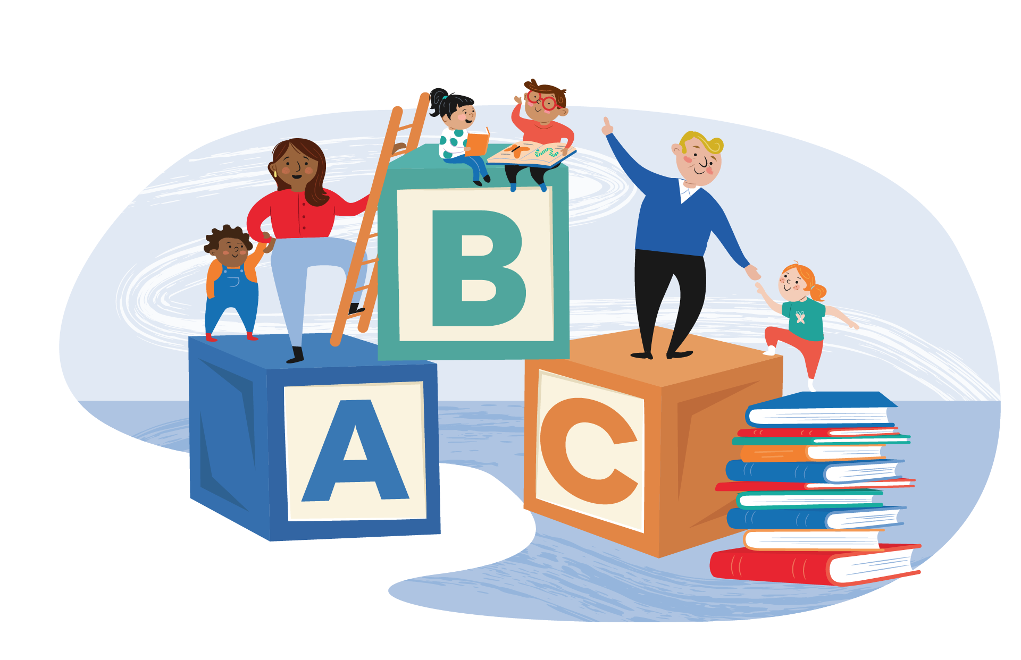
The Science of Reading (SoR)
17

Slide 18
What is the Science of Reading?
A vast, interdisciplinary body of scientifically-based research on how humans learn to read.
18
Notes:
Define SoR as a massive, interdisciplinary convergence of gold-standard empirical data (cognitive science, linguistics, neuroscience) dictating exactly how the human brain acquires literacy.
Explicitly condemn outdated educational methods like "balanced literacy" or the "three-cueing system," which mistakenly teach children to guess words based on pictures or context clues. The brain must be taught to decode systematically.

Slide 19
Decoding (D) × Language Comprehension (LC) = Reading Comprehension (RC)
If either Decoding or Language Comprehension is zero, Reading Comprehension is zero.
19
Notes:
In the first five years of life (before formal schooling), children cannot yet decode. Therefore, the absolute clinical focus of the pediatrician must be to aggressively maximize the Language Comprehension side of the scale (vocabulary, syntax, background knowledge) through talk, song, and interactive print exposure.

Slide 20
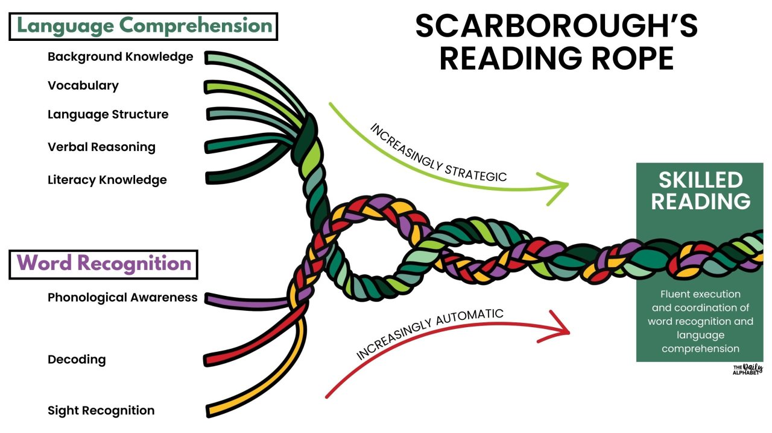
20
Notes:
Drive home the point that early childhood exposure - every nursery rhyme sung, every picture pointed out, every conversation had - is what directly spins and strengthens the individual fibers of that top strand long before school begins.
Consider this prompt for discussion: "If a child's 'top strand' is weak due to early linguistic neglect, what happens to the entire rope when they are suddenly forced to handle complex textbook reading in Grade 4?"

Slide 21
Literacy Milestones
6–12 Months: Explores books via mouthing, pats pictures, reaches for pages.
12–18 Months: Holds a book with help, turns multiple pages at once, vocalizes to pictures.
18–24 Months: Points to named objects, turns pages one by one, mimics reading sounds.
3–5 Years: Recognizes familiar logos, tracks text left-to-right, retells favorite stories.
Notes:
Ensure students know that an infant mouthing, chewing, or slapping a board book at 6-12 months is an essential, normal sensory and fine-motor milestone (not destructive behavior).
Track the evolution: moving from turning multiple pages at once and vocalizing (12-18 months) to pointing at named items and tracking text left-to-right (18 months-3 years).
By age 3-5, a child should exhibit clear print awareness, logographic recognition, and basic narrative retelling. Missing these is a major red flag for reading failure.
Consider this discussion prompt: “A parent tells you their 14-month-old 'hates books' because they just throw them and turn three pages at once. How do you reframe this according to healthy developmental milestones?"

Slide 22
The Canadian Landscape

Slide 23
A Looming Public Health Crisis
One in four Canadian children enters kindergarten lacking the basic pre-literacy skills required to learn how to read.
25% of Canadian grade-three students cannot read at grade level.
50% increase in Canadian children actively struggling with reading since 2018.
48% of working-age adults function below the standard literacy level needed for jobs.
Notes:
Children who fall behind here rarely catch up, cascading into adult life.

Slide 24
Systemic Evolution & Pediatric Advocacy in Canada
The "Right to Read" Era calls for structured literacy programming.
Literacy has been deemed to be a critical SDOH by the CPS.
Programs such as Early Words are actively embedding training directly into clinics.
Notes:
The "Right to Read" Era: Following landmark human rights inquiries (like Ontario's Right to Read report), Canadian provinces are actively overhauling school curricula to remove outdated "guessing" methods and mandate structured literacy.
The Canadian Paediatric Society (CPS) formally frames childhood literacy as a critical social determinant of health.
Current CPS Guidance explicitly charges paediatric providers to use well-child visits to identify at-risk families, provide evidence-based counseling, and write "literacy prescriptions".
Programs like Early Words by the Canadian Children's Literacy Foundation are actively embedding training directly into Canadian clinics to standardize early interventions.

Slide 25

Case Studies

Slide 26
The Missed Developmental Cue
A 15-month-old boy presents for a well-visit. The student hands him a book. The child shows little interest, cannot grip the book, and throws it across the room.
Is this a developmental-behavioural issue, a fine motor delay, or a lack of household book exposure?
Notes:
Drive home that a book is a physical diagnostic instrument. When Liam throws the book or fails to grip it, the clinician should not see "bad behavior." Use books as a physical diagnostic tool to assess pincer grasp, visual tracking, and cognitive curiosity.

Slide 27
The Busy Parent
A single mother of three works two jobs and states, "I don't have 30 minutes a day to sit and read books."
How do you respond?
Notes:
If a working caregiver feels time-pressured, a rigid clinical lecture will only induce guilt and alienation. The physician must pivot the prescription from "reading text" to "language-rich routines."
Coach the parent to organically embed language into existing tasks. Teach her to narrate grocery shopping ("Look at the green broccoli, let's count three apples"), read labels aloud in the kitchen, or sing complex oral stories during transit.

Slide 28
Language Regression & Device Swap
A 24-month-old girl presents for her well-child visit. At 18 months, she had a vocabulary of 20 words. Today, the mother reports she does not use verbal language frequently and exhibits behavioural dysregulation often, but is an "absolute genius" who can unlock an iPad and navigate video streaming apps independently.
How do you counsel this parent?
Notes:
This is a classic "serve-and-return" deprivation presentation. Digital media provides passive stimulation, which lacks the dynamic neural feedback loop required to wire speech centers.
Instruct the parents to slowly replace digital devices with interactive, physical board books where the parent must label items and wait for the child to echo back.
As a physician, you must also address her language regression and not assume it is secondary to high screen exposure. Make a referral to speech-language therapy support while you complete your workup for language regression.
Consider this discussion prompt: “How do you clinically address the illusion of "educational" digital media versus active human linguistic interaction?”

Slide 29
The Struggling Reader
A 7-year-old boy (Grade 2) presents with somatic abdominal pain every school morning. His history reveals he is highly verbal, creative, and excels in science discussions, but his teacher notes he is failing reading tests because he relies on looking at picture clues or guessing words based on the first letter.
Applying the Simple View of Reading, what component of the equation is breaking down here?
Notes:
This child has strong Language Comprehension but a profound failure in Decoding (indicative of potential dyslexia or a lack of explicit, structured phonics instruction). He is hiding his decoding deficit by using "balanced literacy" guessing strategies.
Validate the child's somatic pain as a real physical manifestation of chronic school anxiety. Write a formal referral or educational advocacy letter recommending an immediate, systematic phonics-based reading assessment rather than waiting for him to "grow out of it."

Slide 30

Literacy Promotion in Clinical Interactions

Slide 31
Healthcare practitioners have a unique window
We see children before they enter school.
Families expect developmental guidance from us.
Well-child care creates repeated opportunities.
Books and conversation reveal developmental skills.
Clinical recommendations can normalize literacy as part of health.
We can identify children and families who need additional support.
Notes:
Many families do not have regular contact with early childhood educators or specialized developmental services. Healthcare may be the only universal or near-universal system they encounter during the early years.
A brief recommendation from a trusted healthcare practitioner can reinforce that talking, singing, sharing stories, and looking at books are important for health and development.
Our role is especially important when families experience:
Financial barriers.
Limited access to books or libraries.
Language barriers.
Social isolation.
Housing instability.
Disability or developmental concerns.
Limited access to early childhood programs.
Avoid suggesting that clinicians alone can overcome these structural inequities. The clinical encounter is one part of a broader system of support.

Slide 32

Fact or Myth?
Parents must read in English to prepare their children for English-speaking schools.
Notes:
Immigrant and multi-lingual families frequently receive inaccurate advice stating they must only read in English to prepare their child for Canadian schools. The physician must correct this misconception.
The neurobiological fact is that a powerful primary-language foundation (native heritage language) directly creates the underlying neural architecture necessary to acquire a second language.
Explicitly instruct parents to read, tell stories, converse, and sing in their native heritage language. This preserves family attachment, builds complex syntax networks, and actively accelerates future English literacy.

Slide 33
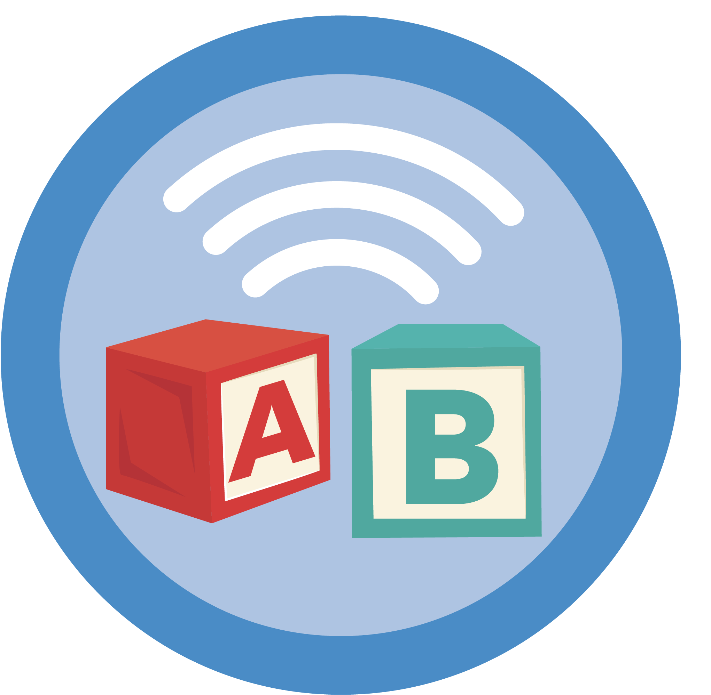
A simple literacy prescription
Every day:
Talk together.
Sing together.
Share stories.
Look at books or pictures.
Follow your child’s interests.
Use the language you know best.
Keep it enjoyable.
A few minutes and a few words at a time matter.
Notes:
Avoid presenting a precise “dose” as though there is a rigid threshold below which families have failed.
The prescription is intended to:
Give the recommendation clinical legitimacy.
Reinforce repetition.
Make the advice memorable.
Emphasize relational interaction.
A prescription pad, after-visit summary, or family handout could include a space for the clinician to write one individualized recommendation.
Example:
“During bath time, name body parts and sing the same song together.”

Slide 34
Practical Exam Room Scripts
“My child won’t sit still.”
“That is normal for many young children. Let them move, choose a page, or look for just a few seconds.”
“We don’t have time.”
“Use a routine you already have. Talk during meals, sing in the car, or tell a short story while getting dressed.”
“We don’t speak English at home.”
“Use the language in which you can connect most naturally. Strong home-language skills are an asset.”
“My baby just chews the book.”
“That is one way babies explore. A sturdy board or cloth book is perfect.”
Notes:
These scripts should be presented as adaptable examples rather than memorized lines.
Encourage practitioners to:
Validate.
Normalize where appropriate.
Offer one practical next step.
Avoid judgment.
Check whether the recommendation feels realistic.

Slide 35
Navigating Digital Media
Canadian Paediatric Society guidelines recommend zero screen time for children under 2 years old, and less than 1 hour per day for children aged 2 to 5.
Notes:
Neuroimaging demonstrates that background TV and solitary tablet use significantly decrease the "serve-and-return" conversational turns required for healthy infant brain development.
Studies show parents use fewer complex words and ask fewer open-ended questions when reading an electronic book compared to a traditional print book.
Do not simply tell parents to turn off devices; provide them with guidance on how to slowly replace it with physical books. Frame the book as a vital tool for emotional regulation and high-quality sleep hygiene.

Slide 36
The Literacy RX Cheat Sheet
The most critical window for structural brain architecture occurs before age 5; if we wait until the child enters school to address literacy deficits, we have missed our prime clinical window.
Reading is an evolutionary hack, not a hardwired instinct. The Left Visual Word Form Area (VWFA) must be systematically trained through explicit decoding and oral language exposure.
A child's early literacy proficiency is a more accurate predictor of their lifelong metabolic, mental, and economic health status than future personal wealth or employment.
Use books as a tool of assessment during clinical interactions.
Physical board books are interventions that stimulate active parent-child "serve-and-return" dialogue. Digital media operates as passive sensory stimulation that can affect speech and language development.
Your signature on a literacy prescription carries significant influence.
Notes:
You can instruct students to use this summary sheet as a primer prior to starting their clerkship rotations for a quick review of key concepts.

Slide 37
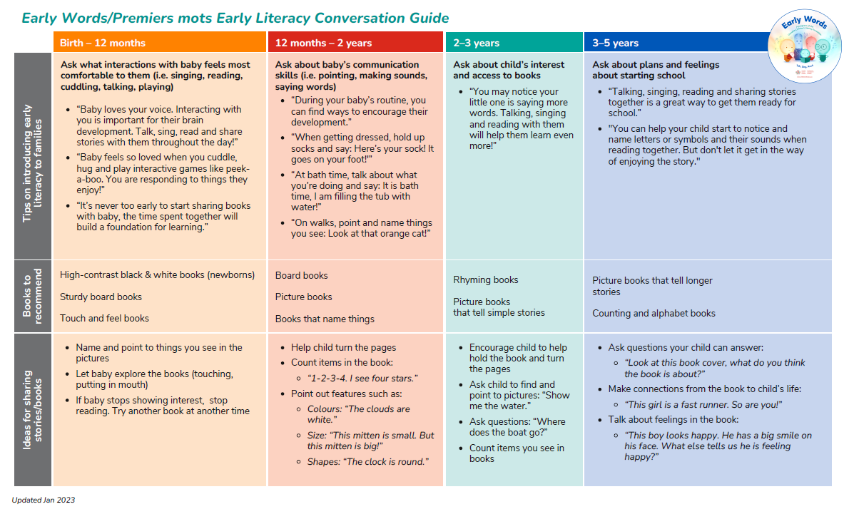
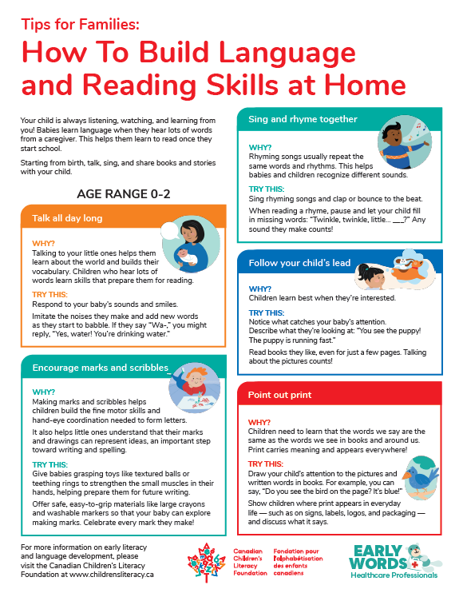
Resources
Canadian Children’s Literacy Foundation
Early Words / Premiers mots
Early Literacy Conversation Guide
Resources for healthcare professionals
Resources for families and caregivers
Books for clinical programs
Canadian Paediatric Society
Read, Speak, Sing
Promoting Early Literacy: A Guide for Clinicians
Early literacy clinic poster
Resources on bilingualism and first-language development
Early Literacy Promotion CME
Notes:
Add QR codes linking to the relevant CCLF and CPS resource pages.
The CCLF Conversation Guide is described as a five- to ten-minute resource for healthcare professionals that includes ways to introduce early literacy activities, reading ideas, and book recommendations for infants, toddlers, and preschoolers.
The CPS early literacy hub includes practice tools, a position statement, a clinician guide, caregiver information, bilingualism guidance, and professional education.

Slide 38
Selected foundational and clinical resources
Canadian Paediatric Society. Read, Speak, Sing: Promoting early literacy in the health care setting.
Canadian Paediatric Society. Promoting Early Literacy: A Guide for Clinicians.
Canadian Children’s Literacy Foundation. Early Words/Premiers mots Early Literacy Conversation Guide.
Castles A, Rastle K, Nation K. Ending the Reading Wars: Reading Acquisition from Novice to Expert. Psychological Science in the Public Interest. 2018.
Gough PB, Tunmer WE. Decoding, reading, and reading disability. Remedial and Special Education. 1986.
Scarborough HS. Connecting early language and literacy to later reading disabilities. In: Handbook for Research in Early Literacy. 2001.
Shonkoff JP, Phillips DA, editors. From Neurons to Neighborhoods: The Science of Early Childhood Development. National Academies Press; 2000.
Reach Out and Read. Evidence and research resources.
Notes:
The final reference list should be reviewed and formatted according to CCLF’s preferred citation style.
Any quantitative claims added during graphic development should be supported by a current, traceable source.

Slide 39
Appendix Index
Appendix A: Supplemental Case Study
Appendix B: Multiple Choice Questions
Appendix C:
  Reading Acquisition: Ending the Reading Wars (Castles et al., 2018) details how children become expert readers.
  Child Development: From Neurons to Neighborhoods (Shonkoff & Phillips, 2000) covers early neurodevelopmental foundations.
  Relational Health: Harvard Center's Serve and Return Interaction guides explain how responsive exchanges actively shape brain architecture.
  Digital Access: Review full developmental materials online at the official Harvard Center repository.
  Podcasts: Sold a Story
Appendix D: Optional Medical Student Pre-Session Reflection Prompts
Appendix E: One-Minute Counselling Framework
Appendix F: Sample After-Visit Check
Appendix G: Sample Clinical Documentation
Appendix H: Clinic Readiness Checklist
Appendix I: Facilitator Discussion Questions

