Slide 1



Literacy as a Vital Sign
Clinical Practice Guide
The Literacy Prescription:
A Medical Student’s Guide to Early Literacy
[Presenter name and credentials]
[Institution or organization]
Notes:
Early literacy is sometimes perceived as an educational issue that begins when a child enters school. In reality, the foundations for language, communication, relationships, and later reading begin in infancy.
Healthcare practitioners have repeated opportunities to support these foundations before children enter school. We can introduce early literacy during routine care, model practical activities, identify concerns, support families facing barriers, and connect families with appropriate resources.
Today’s session focuses on how to make early literacy promotion clinically relevant, equitable, and feasible.

Slide 2
Faculty Disclosure
Faculty disclosure
Presenter: [Name]
Relationships with commercial interests: [Insert]
Financial or in-kind support: [Insert]
Mitigation of potential bias: [Insert]
This presentation includes discussion of publicly available literacy resources.
2
Notes:
Complete according to the accrediting organization’s CME requirements.

Slide 3

Learning Objectives
1
Explain why early literacy is a child health and health equity issue.
Integrate early literacy guidance into routine clinical encounters.
2
Recognize language, developmental, and reading-related concerns requiring further assessment.
3
4
Counsel families using practical, culturally responsive, and multilingual approaches.
5
Identify one feasible change to strengthen early literacy promotion in their practice.
3
Notes:
Emphasize that residents are not expected to become reading specialists or independently administer psychometric assessments outside their training.
The resident’s clinical role is to:
Promote language-rich relationships.
Normalize literacy conversations.
Observe development.
Recognize concerns.
Offer anticipatory guidance.
Connect families with supports.
Present relevant findings to a supervisor and propose an initial plan.
Advocate when systems are not meeting a child’s needs.

Slide 4
Opening Case
“I don’t have time to read.”
A parent of an 18-month-old says:
“I know I’m supposed to read every night, but I work late, I’m exhausted, and she won’t sit still anyway.”
How would you respond?
Notes:
Invite one or two responses from the group.
Listen for whether the proposed responses:
Add another burden to the caregiver.
Assume that reading must involve completing a book.
Recognize the caregiver’s circumstances.
Offer realistic alternatives.
Explore what the family is already doing.
Possible response:
“I can hear how much you are managing. You do not have to finish a book or create a special lesson. Talking while you dress her, singing in the car, or looking at one page together all count. The most important ingredient is your voice and the interaction between you.”
Use this case to introduce a central principle:
Early literacy promotion should reduce pressure and increase connection.

Slide 5
The Central Message
Early literacy is not an extra task.
It is part of:
    Developmental surveillance
    Relational health
    Anticipatory guidance
    School readiness
    Health equity
    Lifelong health
Notes:
Early literacy conversations fit naturally within subjects clinicians already address: communication, attachment, routines, sleep, behaviour, screen use, development, and school functioning.
The Canadian Paediatric Society describes early exposure to books, words, and songs as a way to support vocabulary, later reading, nurturing relationships, and health.
The goal is not simply to teach children letters earlier. It is to strengthen responsive interactions and language-rich environments that support development.

Slide 6
Why Healthcare Practitioners?
Healthcare practitioners have a unique window
We see children before they enter school.
Families expect developmental guidance from us.
Well-child care creates repeated opportunities.
Books and conversation reveal developmental skills.
Clinical recommendations can normalize literacy as part of health.
We can identify children and families who need additional support.
Notes:
Many families do not have regular contact with early childhood educators or specialized developmental services. Healthcare may be the only universal or near-universal system they encounter during the early years.
A brief recommendation from a trusted healthcare practitioner can reinforce that talking, singing, sharing stories, and looking at books are important for health and development.
Our role is especially important when families experience:
Financial barriers.
Limited access to books or libraries.
Language barriers.
Social isolation.
Housing instability.
Disability or developmental concerns.
Limited access to early childhood programs.
Avoid suggesting that clinicians alone can overcome these structural inequities. The clinical encounter is one part of a broader system of support.

Slide 7
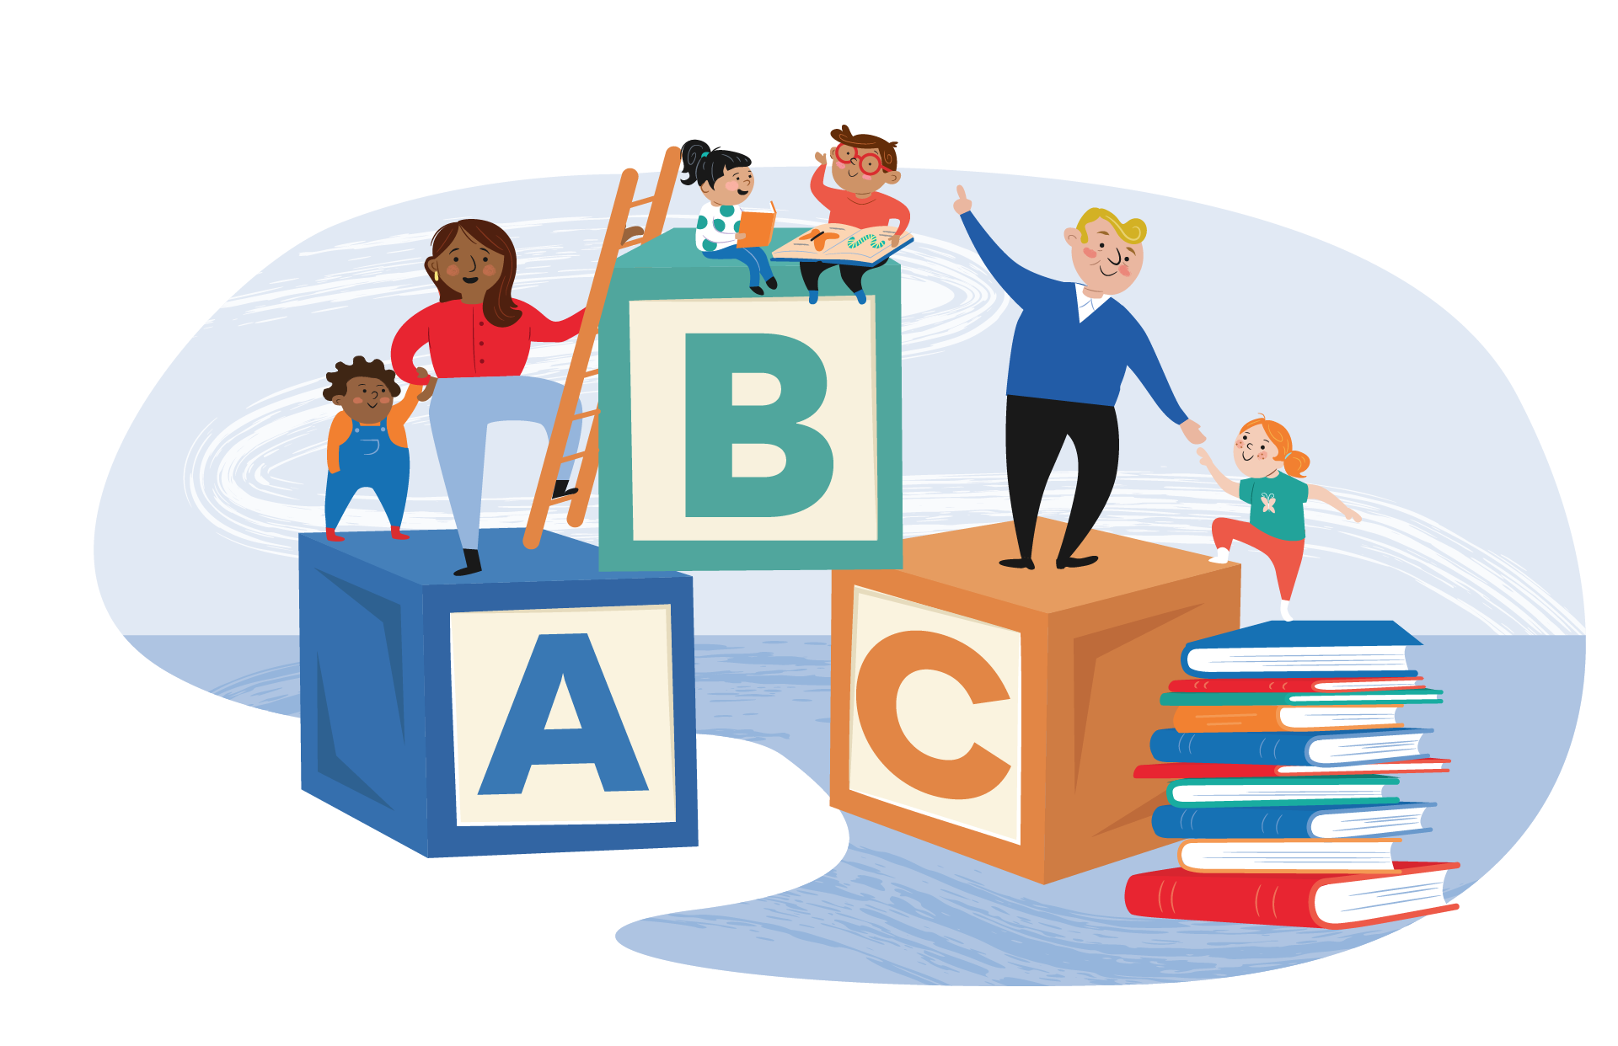
How routinely do you discuss early literacy?
A. Newborn or well-child care
B. Ambulatory general pediatrics
C. Emergency or inpatient care
D. Developmental or subspecialty clinic
E. I am not yet sure where it fits
Notes:
Use a show of hands, electronic poll, or brief reflection.
Ask:
“What makes this conversation easier or harder in your setting?”
Common barriers may include:
Limited time.
Competing priorities.
Lack of books or resources.
Uncertainty about what to recommend.
Concern about caregiver literacy.
Lack of an established clinic workflow.
Feeling that literacy belongs to education rather than healthcare.
Tell participants that the session will address each of these barriers.

Slide 8
How routinely do you discuss early literacy?
A. Newborn or well-child care
B. Ambulatory general pediatrics
C. Emergency or inpatient care
D. Developmental or subspecialty clinic
E. I am not yet sure where it fits
Notes:
Use a show of hands, electronic poll, or brief reflection.
Ask:
“What makes this conversation easier or harder in your setting?”
Common barriers may include:
Limited time.
Competing priorities.
Lack of books or resources.
Uncertainty about what to recommend.
Concern about caregiver literacy.
Lack of an established clinic workflow.
Feeling that literacy belongs to education rather than healthcare.
Tell participants that the session will address each of these barriers.

Slide 9

The clinical science
Language, relationships, development, and later reading
9

Slide 10

Young children learn language through responsive interaction.
The child looks, gestures, vocalizes, or speaks.
The adult notices and responds.
The child receives language connected to their attention.
The interaction continues.
These repeated exchanges build:
Communication
Vocabulary
Attention
Social connection
Emotional regulation
Foundations for later learning
10
Notes:
This is often described as “serve-and-return.”
The child initiates a “serve” through a sound, look, gesture, or word. A responsive adult “returns” the interaction by noticing, naming, imitating, expanding, or responding.
Books are useful because they create frequent opportunities for:
Joint attention.
Pointing.
Naming.
Turn-taking.
Prediction.
Emotional connection.
Repetition.
However, books are not the only way to create these exchanges. Songs, family stories, daily conversation, rhymes, and oral traditions are also valuable. These must be included when assessing literacy exposure in a household. This information may also help you to provide literacy guidance that resonates more closely with a family.

Slide 11

The goal is not finishing the book.
The goal is the interaction.
Shared reading can include:
Looking at one picture
Naming what the child notices
Asking and answering questions
Making sounds
Connecting the story to the child’s life
Letting the child turn pages
Repeating a favourite book
Stopping when the child is finished
11
Notes:
Many caregivers believe they are “doing it wrong” if the child does not sit quietly or if they cannot finish every page.
Clarify that developmentally appropriate shared reading is flexible and interactive.
An infant may chew a board book. A toddler may turn several pages at once. A preschooler may interrupt repeatedly or tell a different story from the pictures. These behaviours can all be part of healthy engagement.
The clinician’s job is to help caregivers recognize and enjoy what the child can do now.

Slide 12

Later reading comprehension depends on more than recognizing words
Word recognition
Phonological awareness
Letter-sound knowledge
Decoding
Reading fluency
Language comprehension
Vocabulary
Sentence structure
Background knowledge
Verbal reasoning
Understanding stories and concepts
Decoding × language comprehension = reading comprehension
12
Notes:
A useful framework is the Simple View of Reading:
Decoding × language comprehension = reading comprehension
Young children are not expected to decode words. Before school, healthcare practitioners primarily help strengthen the oral language and relational foundations that support later comprehension.
Clinicians should avoid implying that reading aloud alone prevents all reading disabilities. Dyslexia and other learning disorders have neurodevelopmental foundations and require appropriate identification and evidence-based instruction.
Early literacy promotion supports development broadly, but it is not a substitute for structured reading instruction or specialized intervention when required.

Slide 13
Early literacy can influence health through multiple pathways
Early language and literacy
↓
School engagement and achievement
↓
Educational and employment opportunities
↓
Ability to access and use information
↓
Health literacy, healthcare navigation, and health outcomes
13
Notes:
Literacy affects how people understand health information, communicate with services, complete forms, interpret medication instructions, and navigate healthcare systems.
These relationships are not deterministic. Literacy does not operate independently of poverty, racism, disability, access to education, housing, migration, or other social determinants.
The clinical message is not that individual families must read their way out of structural inequity.
The message is that literacy is one modifiable and meaningful component of healthy development, while healthcare systems must also address structural barriers.

Slide 14
Opportunities for early language and literacy are not distributed equally
Barriers may include:
  Cost and availability of books
  Limited library or transportation access
  Caregiver work schedules
  Housing instability
  Disability or chronic illness
  Racism and social exclusion
  Lack of culturally relevant materials
  Limited materials in the family’s language
  Caregiver experiences of school-related shame
  Digital and information inequities
14
Notes:
Avoid asking only, “Do you read to your child?”
That question can feel evaluative and can generate a yes-or-no answer without revealing useful information.
Consider asking:
“What does your child enjoy looking at or listening to?”
“What songs or stories are part of your family?”
“Which languages do you use together?”
“When during the day do you get a chance to talk or play?”
“What makes sharing books easy or difficult?”
These questions recognize family strengths while identifying opportunities and barriers.

Slide 15


What Can residents Do?
Ask. Observe. Encourage. Model. Connect.

Slide 16
A – O – E – M - C
Ask - about language, stories, books, songs, and screens.
Observe - the child’s communication and interaction.
Encourage - simple, enjoyable, language-rich routines.
Model - one developmentally appropriate activity.
Connect - families with books, libraries, programs, and assessment when needed.
Notes:
This can be completed in one to three minutes during many routine encounters.
The acronym does not need to appear in family-facing material. It is intended as a memory aid for practitioners.

Slide 17
Try asking:
“What songs or stories does your child enjoy?”
“What does your child do when you look at a book together?”
“Who tells stories or sings with your child?”
“Which languages does your family use at home?”
“What does your child like to point to or talk about?”
“Are there any concerns about hearing, speech, language, or learning?”
“What gets in the way of sharing books or stories?”
Notes:
The purpose is not to audit the family.
Use curiosity rather than judgment.
A family may have few physical books but a rich tradition of oral storytelling. Another family may own many books but struggle to find time or confidence. A caregiver may have difficulty reading print but be highly skilled at conversation, songs, and storytelling.
The questions should help identify both strengths and unmet needs.

Slide 18
A book can provide a window into development
Observe:
Visual attention and tracking
Reaching and grasp
Page turning
Pointing and showing
Joint attention
Naming and imitation
Receptive language
Narrative skills
Caregiver-child interaction
Regulation and persistence
Notes:
Offer the book near the beginning of the encounter rather than only at the end.
Observe without turning the interaction into a pass-fail test.
Examples:
Does the infant orient to the picture or caregiver’s voice?
Does the toddler point or bring the book to an adult?
Does the child follow a simple prompt such as “Where is the dog?”
Does the preschooler label, predict, or tell a story?
Does the caregiver follow the child’s interest?
Does the child tolerate or enjoy the interaction?
A single observation is not diagnostic. Interpret it alongside history, developmental surveillance, hearing, language exposure, behaviour, and the child’s comfort in the clinical environment.

Slide 19
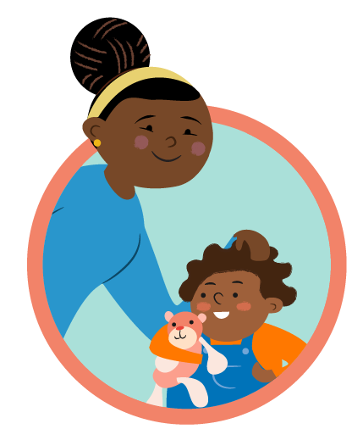
Give one or two recommendations—not a lecture
Follow the child’s interest
Talk about what the child notices.
Make it interactive
Point, name, pause, imitate, and respond.
Make it easy to repeat
Use a routine that already exists.
Notes:
Choose recommendations that match the family’s circumstances.
Examples:
During feeding: name foods, colours, and actions.
During dressing: name body parts and clothing.
On the bus: notice signs, vehicles, and sounds.
At bedtime: look at one page or tell a family story.
During diaper changes: sing the same song each time.
At the grocery store: name and compare items.
In a waiting room: describe pictures together.
Small, repeatable actions are more useful than an idealized recommendation that families cannot sustain.

Slide 20
A 20-second demonstration can build caregiver confidence
Follow the child’s gaze.
Point to a picture.
Name or describe it.
Pause for the child.
Respond to any sound, gesture, or word.
Expand slightly.
Child: “Dog.”
Adult: “Yes—a big brown dog is running!”
Notes:
Many caregivers have been told to read but have never been shown what interactive shared reading can look like.
Model the behaviour briefly during the visit.
The demonstration should feel supportive rather than corrective.
Possible phrase:
“He is really interested in that dog. You can follow what he notices, name it, and then add one more idea. You do not need to read every word on the page.”

Slide 21
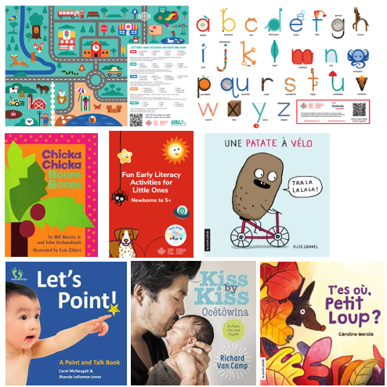
Clinical counselling is stronger when families leave with support
Consider:
An age-appropriate book
Library information or registration
CCLF family resources
EarlyON or local early years programs
Public health programs
Speech-language services
Hearing assessment
Developmental services
School-based supports
Culturally and linguistically relevant resources
Notes:
Advice without access may increase frustration.
Develop a short, locally relevant resource list rather than giving families an overwhelming directory.
Consider whether the family can realistically access the service:
Is transportation required?
Is the service free?
Is interpretation available?
Is identification required?
Is there a wait-list?
Is the resource available in the family’s language?
Is the program accessible for children with disabilities?

Slide 22
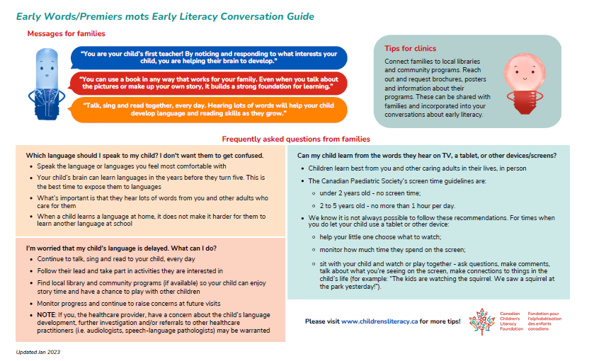
Early Words / Premiers mots
Early Literacy Conversation Guide
Designed to support brief healthcare conversations about:
Early literacy activities
Reading together
Developmentally appropriate strategies
Books to recommend
Infants, toddlers, and preschool-aged children
Approximate completion time: 5–10 minutes
Notes:
The Canadian Children’s Literacy Foundation’s Early Words Conversation Guide is designed for use by healthcare professionals.
It includes ways to introduce early literacy activities, ideas for reading together, and suggested books for different developmental stages.
The guide can be used:
As individual clinician preparation.
During staff onboarding.
For team training.
As part of a clinic implementation initiative.
To develop consistent language across a practice.

Slide 23
Read. Speak. Sing.
The Canadian Paediatric Society encourages healthcare practitioners to promote:
  Reading
    Share books and pictures from infancy.
  Speaking
    Talk throughout daily routines and respond to the child.
  Singing
    Use songs, rhymes, rhythm, and repetition.
Notes:
The CPS early literacy resources include:
A position statement on promoting early literacy in healthcare settings.
A clinician guide with conversation starters.
Clinic posters.
Parent-facing information.
Videos.
Resources related to bilingualism and first-language development.
A self-directed CME activity.
The central message is accessible: early language exposure can occur through books, words, songs, and warm interactions with trusted adults.

Slide 24
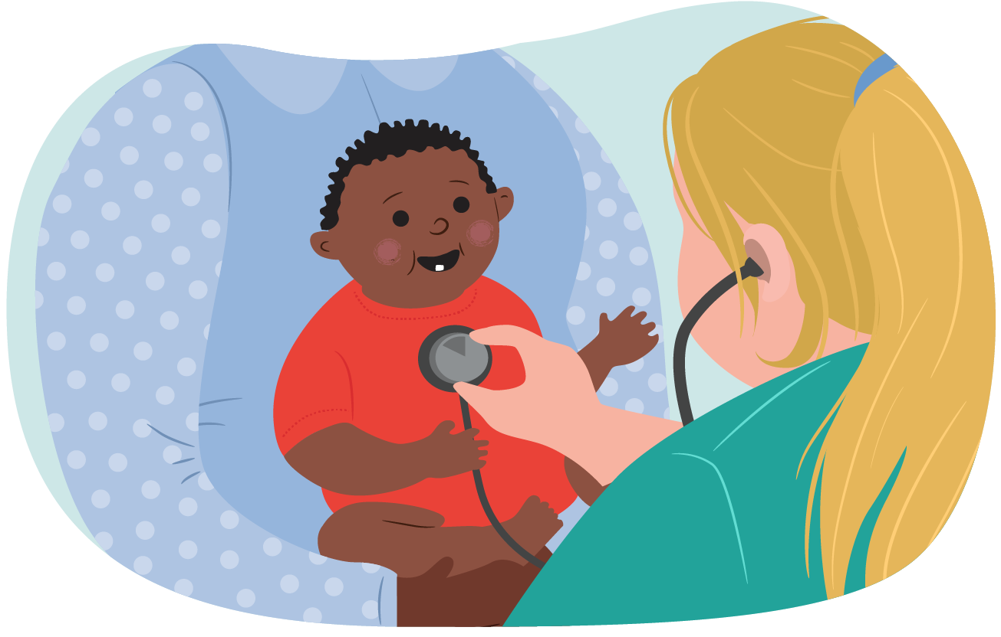
Infants: birth to 12 months
Encourage caregivers to:
  Hold the baby close.
  Talk about pictures.
  Use facial expression and an animated voice.
  Repeat sounds the baby makes.
  Sing familiar songs.
  Let the baby touch, grasp, and mouth sturdy books.
  Follow the baby’s attention.
  Stop when the baby becomes tired or overwhelmed.
Notes:
Books for infants should generally be:
Durable.
Visually clear.
Easy to hold.
Safe for sensory exploration.
Relevant to the family’s language and experiences.
Possible clinician script:
“Your baby does not understand the story yet, but they recognize your voice and learn from the back-and-forth between you. Looking at one picture together is enough.”

Slide 25

Toddlers: approximately 1 to 3 years
Encourage caregivers to:
    Let the child choose the book.
    Name pictures the child notices.
    Use short phrases.
    Ask simple questions.
    Pause and allow time to respond.
    Repeat favourite books.
    Let the child move while listening.
    Connect pictures to everyday life.
    Accept short interactions.
Notes:
Possible clinician script:
“Toddlers are not expected to sit quietly through a whole story. Follow their interest. One page, one picture, or one repeated phrase can be a successful reading experience.”
Encourage expansion:
Child says: “Car.”
Caregiver says: “Yes, a red car. The car is going fast.”

Slide 26
Preschoolers: approximately 3 to 5 years
Encourage caregivers to:
    Ask what might happen next.
    Invite the child to retell the story.
    Discuss feelings and motivations.
    Connect stories to the child’s life.
    Introduce new words naturally.
    Notice rhyme and sounds.
    Let the child “read” from memory or pictures.
    Visit the library together.
    Continue reading in the home language.
Notes:
Possible prompts include:
“What do you think will happen?”
“Why is the character feeling sad?”
“What would you do?”
“Can you find something else that is red?”
“What happened at the beginning?”
“Does this remind you of anything?”
Avoid turning reading into a quiz. Maintain enjoyment and connection.

Slide 27
School-aged children still benefit from shared reading
Encourage families to:
    Continue reading aloud.
    Discuss stories, information, and current events.
    Let the child choose topics of interest.
    Use audiobooks alongside print when helpful.
    Separate reading enjoyment from performance.
    Watch for frustration, avoidance, or guessing.
    Ask the school for specific assessment data when concerns arise.
Notes:
Shared reading should not stop when a child begins reading independently.
Reading aloud can expose children to:
More complex vocabulary.
Background knowledge.
Narrative structure.
Topics above their independent reading level.
Enjoyment without performance pressure.
Audiobooks can support access, comprehension, and enjoyment, but should not be used as a reason to ignore a possible decoding difficulty.

Slide 28


An equity-oriented approach
Language, culture, access, and caregiver confidence

Slide 29
Use the language you know best.
Families should be encouraged to:
Talk, sing, read, and tell stories in their strongest language.
Maintain meaningful family communication.
Use all languages that are part of family life.
Choose books or stories that reflect their culture.
Avoid replacing rich home-language interaction with limited interaction in English or French.
Notes:
Learning more than one language does not cause a language disorder.
A strong foundation in a child’s first language supports communication, relationships, identity, and learning.
When assessing a multilingual child:
Ask about all languages used.
Determine exposure and proficiency in each language.
Ask whether concerns are present across languages.
Avoid evaluating the child’s abilities only in English or French.
Use qualified interpreters where available.
Consider referral to professionals experienced in multilingual development.
Possible script:
“The best language for building your child’s language is the one in which you can talk, joke, sing, explain, and connect most naturally.”

Slide 30
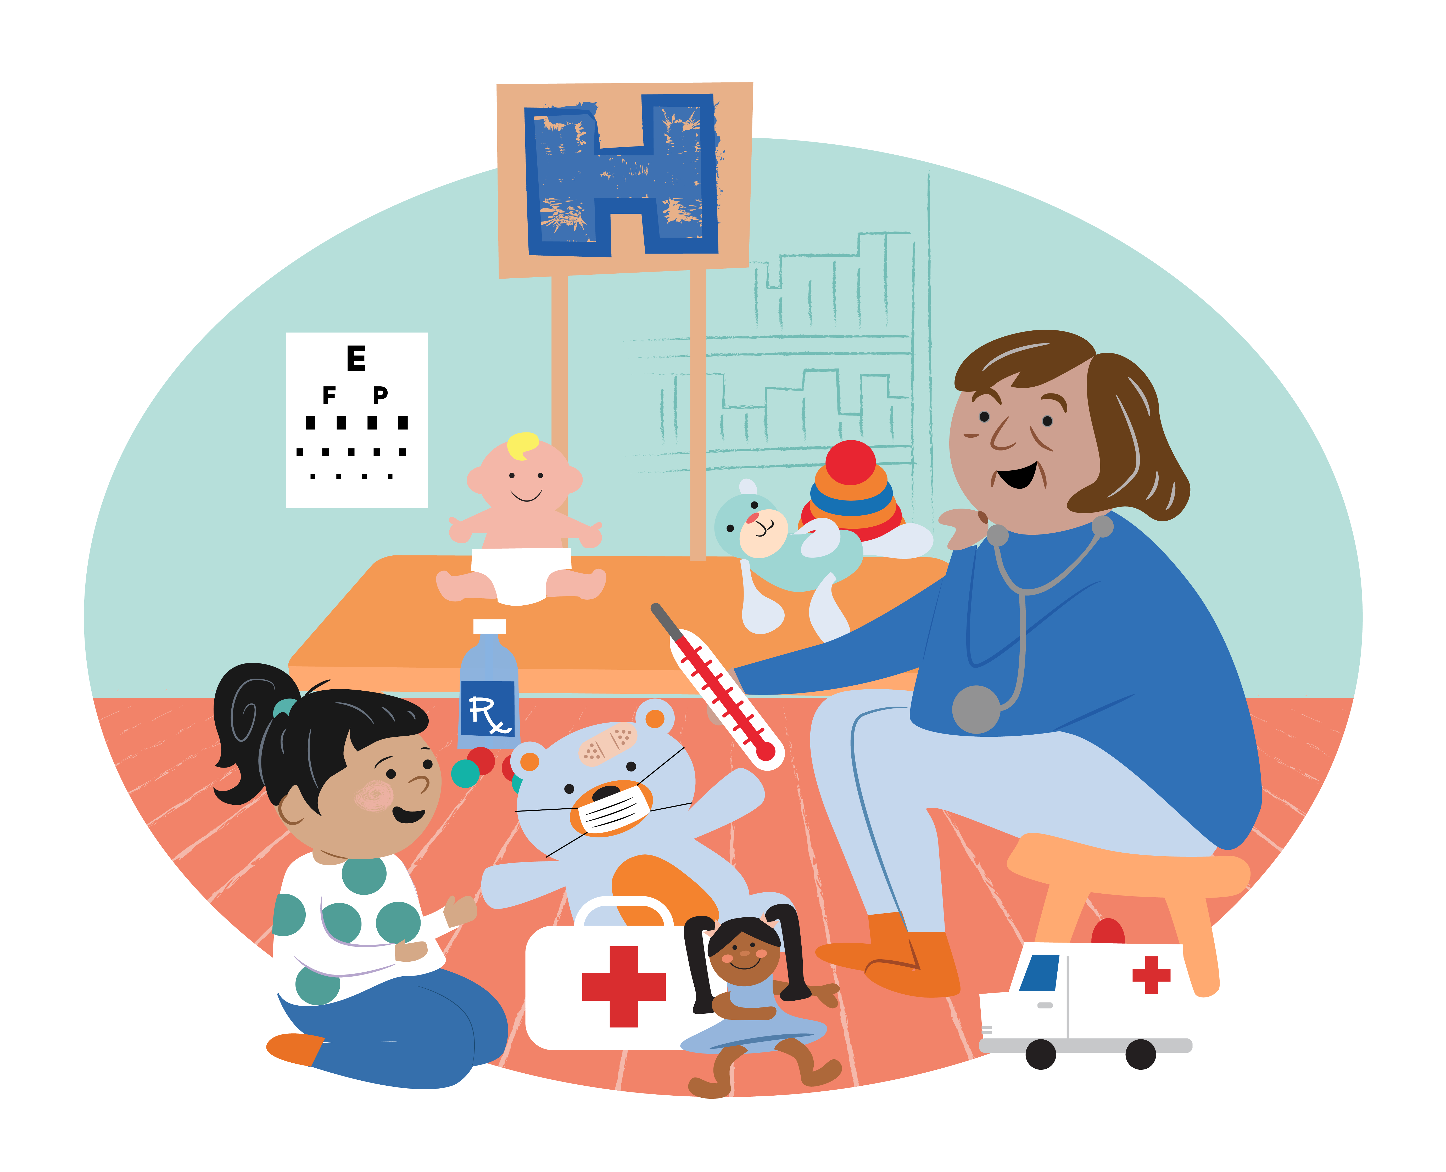
Do not assume that limited reading ability means limited ability to support a child
Caregivers can:
  Tell family stories.
  Describe pictures.
  Sing.
  Use rhymes.
  Name objects and actions.
  Share wordless books.
  Listen to audiobooks together.
  Ask another trusted adult to read.
  Use library and community programs.
Notes:
Approach this subject carefully. Many adults have experienced shame, discrimination, or exclusion related to school and literacy.
Do not ask, “Can you read?” in a public or abrupt manner.
Consider:
“Some parents prefer telling stories or talking about the pictures rather than reading the words. What feels most comfortable for you?”
Provide wordless books, simple picture books, audio resources, and non-print options.
Never ask an older sibling to assume primary responsibility for the child’s literacy development, although shared sibling reading can be enjoyable when it occurs naturally.

Slide 31
Families are more likely to engage when resources reflect them
Consider:
    Language
    Names and family structures
    Skin tones and hair
    Clothing and food
    Disability representation
    Rural, northern, and urban settings
    Indigenous stories and authors
    Migration and newcomer experiences
    Family and community traditions
Notes:
Representation should not be reduced to appearance alone.
Culturally responsive resources can support:
Belonging.
Identity.
Family conversation.
Intergenerational storytelling.
Trust in the recommendation.
Ask families what stories, songs, and traditions are meaningful to them.
Avoid recommending culturally specific materials without understanding whether they are authentic, appropriate, and welcomed by the community represented.

Slide 32
The key question is not only “How much screen time?”
Also ask:
    Is the child using the screen alone or with an adult?
    Is the content age-appropriate?
    Is screen use displacing sleep, movement, play, or conversation?
    Does the caregiver talk about what the child is seeing?
    Can a digital activity lead into an offline interaction?
    Is the screen being used because the family lacks alternatives or support?
Notes:
Avoid simplistic or shaming messages.
Screen use is shaped by caregiver workload, housing, childcare, disability, access to safe play spaces, and other realities.
Emphasize that young children learn best through responsive human interaction.
Co-viewing and discussing content are generally more interactive than solitary viewing. However, digital media should not routinely displace sleep, physical activity, in-person interaction, play, and shared language experiences.
Possible counselling pivot:
“Rather than trying to change everything at once, choose one part of the day when the screen can be replaced with talking, singing, play, or looking at a book together.”

Slide 33
Early literacy promotion does not replace developmental assessment
Consider further assessment when there are concerns about:
Hearing
Loss of previously acquired skills
Limited response to sound, voice, or name
Limited gestures or joint attention
Delayed understanding or use of language
Speech that is difficult to understand
Social communication
Motor or vision skills affecting book interaction
Persistent behavioural dysregulation
Broader developmental differences
Caregiver concern
Notes:
Do not attribute delayed language automatically to:
Bilingualism.
Being a boy.
An older sibling “speaking for” the child.
Screen exposure.
Lack of reading.
A child simply developing at their own pace.
Language delay can have multiple contributors, including hearing differences, developmental language disorder, autism, global developmental delay, neurological conditions, psychosocial adversity, and environmental factors.
When concerns are present, follow standard developmental and clinical pathways.

Slide 34
Ask about reading when children present with:
  School avoidance
  Recurrent morning abdominal pain or headaches
  Anxiety related to school
  Behavioural escalation during homework
  Slow or effortful reading
  Difficulty sounding out unfamiliar words
  Guessing based on pictures or first letters
  Poor spelling
  Strong oral knowledge but weak reading
  Family history of dyslexia or reading difficulty
  Declining confidence
Notes:
Reading difficulty may present clinically through emotional, behavioural, or somatic symptoms.
Ask:
“How does your child feel about reading?”
“Can your child sound out unfamiliar words?”
“Do they avoid reading aloud?”
“What does the teacher say about decoding, fluency, and comprehension?”
“What interventions have been provided?”
“Is there a family history of reading difficulty?”
“Have hearing and vision been assessed?”
Do not reassure families simply that the child will “catch up.”
Early, structured, evidence-based intervention is important.

Slide 35
Clarify the pattern before proposing the next step
History
Onset, trajectory, instruction, and interventions
Reading accuracy, fluency, decoding, spelling, and comprehension
Oral language, attention, anxiety, hearing, and vision
Family history and the child’s strengths
Initial data to request
Teacher observations and attendance
Results of school-based reading measures
Response to structured intervention
Individual education or learning plan, when available
Notes:
Dyslexia is a neurodevelopmental learning disorder.
A child may have:
Strong verbal reasoning.
Creativity.
Excellent factual knowledge.
Strong listening comprehension.
Persistent difficulty decoding printed words.
Residents do not need to diagnose dyslexia during a routine visit, but should recognize a concerning pattern, validate the child’s experience, and support timely assessment and intervention.
Ask schools for specific information rather than accepting statements such as “The child is below level.”
Useful data include:
Letter-sound knowledge.
Phonemic awareness.
Word reading.
Non-word decoding.
Oral reading fluency.
Spelling.
Listening comprehension.
Reading comprehension.
Brief office assessment may include listening to the child read an unfamiliar grade-appropriate passage, asking how they approach an unfamiliar word, comparing listening with reading comprehension, and reviewing writing or schoolwork. These observations can sharpen the history but do not establish or exclude a specific learning disorder.
Standardized tools such as the OWLS, PPVT, EVT, KBIT, or selected subtests should not be presented as quick stand-alone screens unless the clinician has appropriate training, access to current licensed materials, and a clear understanding of the tool’s norms and limits. A partial psychometric assessment can produce misleading reassurance or concern. Residents should use locally approved pathways and review test selection and interpretation with an appropriately trained supervisor, psychologist, speech-language pathologist, or education professional.

Slide 36
Case 1 – The Time Pressed Caregiver
A single parent of three children works irregular shifts and says:
“I barely have time to get everyone fed and into bed. Reading every night is not realistic.”
Discuss
What strengths can you identify?
What should you avoid saying?
What is one realistic recommendation?
Notes:
Possible strengths:
The caregiver is meeting significant family responsibilities.
The caregiver is honest about the barrier.
Existing routines can be used for language interaction.
Avoid:
“Everyone can find ten minutes.”
Prescribing a rigid nightly routine.
Implying that the caregiver is harming the child.
Providing a long list of recommendations.
Possible response:
“You already spend many parts of the day caring for and talking with your children. Let’s build on one routine that already happens. You might sing while getting dressed, talk about food during dinner, or tell a short family story at bedtime. It does not have to involve finishing a book.”

Slide 37
The Active Toddler
Case
A caregiver says:
“He hates books. He grabs them, skips pages, and runs away after 30 seconds.”
What would you say?
Notes:
Suggested response:
“That sounds very typical for a toddler. He does not have to sit still or finish the story. Let him choose the book, turn the pages, or look at one picture. You can name what he notices and stop when he is done. Thirty seconds of enjoyable interaction is a successful start.”
Clinical teaching points:
Normalize developmentally typical behaviour.
Use durable board books.
Follow the child’s interest.
Avoid forcing participation.
Repeat brief experiences.
Consider broader developmental assessment only if other concerns are present.

Slide 38
The Multi-Lingual Pre-schooler
Case
A four-year-old speaks Punjabi with grandparents, English at childcare, and understands both languages.
The family has been told:
“Stop speaking Punjabi so she doesn’t become confused.”
How should the clinician respond?
Notes:
Suggested response:
“Using Punjabi will not confuse her or cause a language disorder. Continue speaking, singing, and telling stories in the language your family uses most naturally. Strong communication in Punjabi supports family relationships and provides a foundation for learning other languages.”
Additional assessment questions:
What does the child understand and say in each language?
Are concerns present in both languages?
How much exposure does the child have to each language?
Is there any hearing concern?
How does the child communicate nonverbally?
What do family members and educators observe?
Refer when concerns are significant across languages or broader developmental concerns are present.

Slide 39
The “Bright” Struggling Reader
Case
A seven-year-old has strong verbal knowledge and loves science but:
  Avoids reading aloud
  Guesses words from pictures
  Has morning stomach aches
  Becomes distressed during homework
  Is told to “try harder”
What may be happening?
Notes:
This pattern raises concern about a decoding-based reading disorder, including possible dyslexia.
The abdominal pain may be a genuine manifestation of anticipatory distress rather than malingering.
Recommended actions:
Validate the child’s experience.
Ask for specific school reading data.
Assess hearing and vision where indicated.
Consider ADHD, anxiety, language, and other learning concerns.
Advocate for evidence-based reading assessment and intervention.
Avoid waiting for the child to fail further.
Support access to content through read-alouds or audiobooks while decoding is addressed.
Possible clinician statement:
“Your child’s difficulty reading does not mean they are not intelligent or not trying. The pattern suggests that reading words is taking much more effort than it should. We need more information about decoding and fluency and a plan for structured support.”

Slide 40
Caregiver Print-Literacy Barrier
Case
A caregiver quietly says:
“I don’t read very well myself, so I don’t know how I’m supposed to teach her.”
What is a supportive response?
Notes:
Suggested response:
“You do not have to teach reading or read every word in the book. You can look at the pictures, tell a story in your own words, sing songs, or talk about your day. Your child benefits from hearing your voice and sharing that time with you.”
Offer:
Wordless picture books.
Books in the caregiver’s preferred language.
Audiobooks.
Library story programs.
Family literacy programs.
Support for the caregiver, if welcomed.
Do not expose or document the caregiver’s literacy status unnecessarily. Maintain dignity and confidentiality.

Slide 41
Practical Exam Room Scripts
“My child won’t sit still.”
“That is normal for many young children. Let them move, choose a page, or look for just a few seconds.”
“We don’t have time.”
“Use a routine you already have. Talk during meals, sing in the car, or tell a short story while getting dressed.”
“We don’t speak English at home.”
“Use the language in which you can connect most naturally. Strong home-language skills are an asset.”
“My baby just chews the book.”
“That is one way babies explore. A sturdy board or cloth book is perfect.”
Notes:
These scripts should be presented as adaptable examples rather than memorized lines.
Encourage practitioners to:
Validate.
Normalize where appropriate.
Offer one practical next step.
Avoid judgment.
Check whether the recommendation feels realistic.

Slide 42
Early literacy promotion works best as a team process
Before the visit:
Books or resources are visible and accessible.
Staff know the core message.
EMR prompts are available.
During the visit:
Offer the book early.
Observe interaction.
Give one tailored recommendation.
Identify concerns.
After the visit:
Document counselling.
Provide the book or resource.
Refer or connect when needed.
Notes:
Implementation should not depend entirely on one enthusiastic clinician.
Possible team roles:
Reception staff display library or program information.
Nursing staff offer the book and ask an opening question.
The clinician observes, reinforces, and addresses concerns.
Administrative staff maintain resource lists.
A clinic champion reviews workflow and data.
Adapt the process to the setting. A neonatal clinic, emergency department, family practice, developmental clinic, and community health centre will require different workflows.

Slide 43
Place the book in the child’s hands early.
This allows the clinician to:
  Observe development.
  Model interaction.
  Reduce waiting-room stress.
  Support regulation.
  Start the literacy conversation naturally.
  Avoid treating the book as a last-minute giveaway.
Notes:
When possible, give the book near the beginning of the encounter.
Possible introduction:
“This book is yours to keep. Let’s see what catches her attention.”
The practitioner can then observe the interaction while taking the history.
At the end of the visit, reinforce one specific observation:
“He really enjoyed pointing to the animals. At home, you can follow his lead, name the animal, and make the sound together.”

Slide 44
Example resident note or handover elements
Early literacy discussed:
□ Yes □ No □ Deferred
Activities reviewed:
□ Talking □ Singing □ Shared reading □ Storytelling
Home language(s): __________
Book or resource provided:
□ Yes □ No
Developmental or literacy concern identified:
□ No □ Yes—follow-up arranged
Supervisor or follow-up clinician informed:
□ Not required □ Yes □ Pending discussion
Notes:
The goal is concise, clinically relevant documentation rather than a checklist in every note.
A brief entry can:
Normalize literacy as part of anticipatory guidance.
Support consistency across clinicians.
Track whether resources were provided.
Facilitate quality improvement.
Prompt follow-up when concerns are identified.
Ensure that documentation does not stigmatize families or record assumptions about caregiver literacy, language, or engagement.
When a concern falls outside the immediate service, state who received the information and who is expected to follow up. Residents should not write that a referral “will be arranged” unless the responsible clinician and process are clear.

Slide 45
Start with a small, measurable change
Process measures
  Percentage of eligible visits with literacy counselling
  Percentage of children receiving a book
  Percentage of clinicians using a standard conversation guide
  Percentage of staff completing training
Balancing measures
  Visit length
  Staff workload
  Book supply
  Family acceptability
  Equity of reach
Notes:
A practice could begin with one age group, one clinician, or one clinic session.
Example aim:
“Over the next three months, we will document an early literacy conversation and offer an age-appropriate book at 75% of 12- and 18-month well-child visits.”
Review who is not being reached.
For example:
Are resources consistently offered in all languages?
Are children with disabilities included?
Are virtual-care families excluded?
Does the process depend on the family asking?
Are books appropriate for the communities served?

Slide 46
Healthcare should not work alone
Potential partners:
  Public libraries
  EarlyON and early childhood programs
  Public health
  Schools and school boards
  Speech-language services
  Family resource centres
  Indigenous organizations
  Newcomer-serving agencies
  Disability organizations
  Community and cultural organizations
Notes:
Consider developing a “warm connection” rather than simply handing out a website.
Examples:
Library staff attend a clinic event.
Families can register for a library card in the clinic.
A local program provides multilingual materials.
Clinic staff receive updates about available services.
A community organization reviews resources for cultural relevance.
Families help co-design the clinic’s literacy initiative.
Partnerships can also support advocacy related to access, book deserts, library funding, and inclusive early childhood services.

Slide 47
Avoid these common pitfalls
Do not shame families.
Do not prescribe an unrealistic routine.
Do not equate literacy with English or French only.
Do not treat book ownership as the only measure.
Do not blame screens for every language concern.
Do not dismiss persistent reading difficulty.
Do not delay assessment because a child is multilingual.
Do not assume families have access to recommended services.
Do not turn shared reading into a performance test.
Notes:
Early literacy promotion should strengthen relationships and caregiver confidence.
The clinical message should be:
“You are already an important part of your child’s learning. Let’s find a way to build language and connection that works for your family.”

Slide 48
A – O – E – M - C
Ask – about language-rich routines and barriers.
Observe - communication, development, and interaction.
Encourage - one realistic activity.
Model - a brief responsive exchange.
Connect -the family with books, services, and community supports.
Notes:
This is the core practice summary.
Emphasize that clinicians do not need to cover every point during every visit.
A brief, tailored intervention delivered consistently over time is more likely to be useful than a lengthy lecture delivered once.
For residents, safe care also requires clear supervision and handover. Identifying a concern without establishing who will follow it can widen rather than reduce gaps in care.

Slide 49

A simple literacy prescription
Every day:
Talk together.
Sing together.
Share stories.
Look at books or pictures.
Follow your child’s interests.
Use the language you know best.
Keep it enjoyable.
A few minutes and a few words at a time matter.
Notes:
Avoid presenting a precise “dose” as though there is a rigid threshold below which families have failed.
The prescription is intended to:
Give the recommendation clinical legitimacy.
Reinforce repetition.
Make the advice memorable.
Emphasize relational interaction.
A prescription pad, after-visit summary, or family handout could include a space for the clinician to write one individualized recommendation.
Example:
“During bath time, name body parts and sing the same song together.”

Slide 50
What is one change you will make?
Add one literacy question to well-child visits.
Place books in the examination room.
Learn one multilingual counselling script.
Use the Early Words Conversation Guide.
Add an EMR prompt.
Update the clinic’s referral list.
Connect with the local library.
Discuss implementation with the clinical team.
Notes:
Ask participants to write down one action.
For accredited CME, this can become a commitment-to-change exercise.
Optional follow-up questions:
What is the first step?
Who needs to be involved?
What barrier do you anticipate?
How will you know whether the change occurred?

Slide 51
Literacy is a Vital Sign
Early language develops through responsive relationships.
Healthcare practitioners have an important early window.
Brief literacy conversations can fit into routine care.
Support the family’s strongest language and existing strengths.
Books can support observation, modelling, and connection.
Literacy promotion does not replace developmental assessment.
Persistent reading difficulty deserves timely attention.
Sustainable practice change requires a team and community approach.
Notes:
End by returning to the opening case.
A caregiver who says, “I don’t have time to read,” may not need a stronger warning. They may need validation, a practical alternative, and access to resources.
The goal is not to turn every caregiver into a formal reading instructor.
The goal is to make language, stories, books, songs, and responsive interaction a routine part of healthy childhood—and a routine part of healthcare.

Slide 52
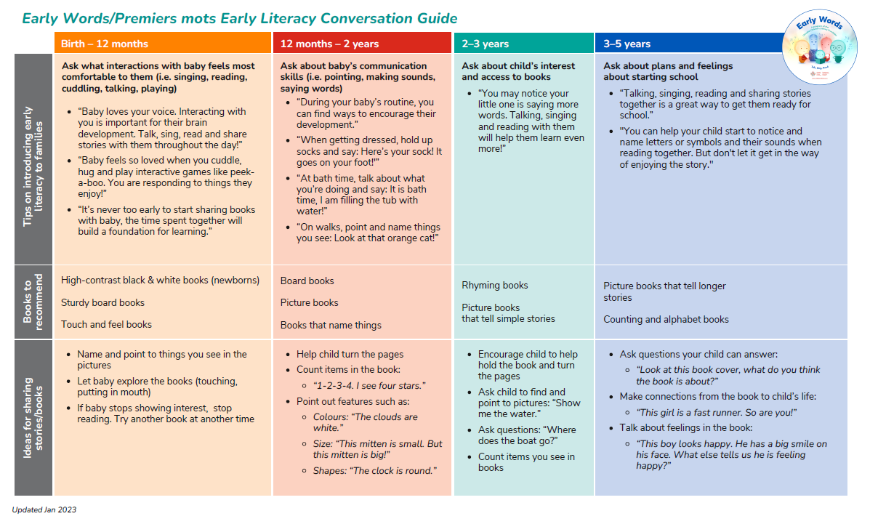
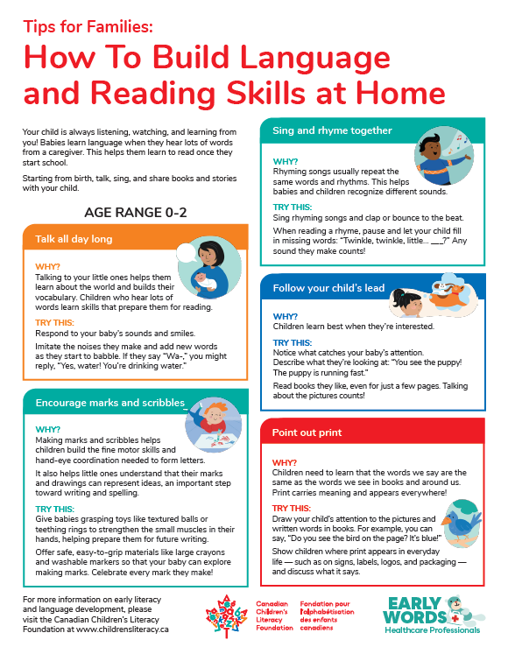
Resources
Canadian Children’s Literacy Foundation
Early Words / Premiers mots
Early Literacy Conversation Guide
Resources for healthcare professionals
Resources for families and caregivers
Books for clinical programs
Canadian Paediatric Society
Read, Speak, Sing
Promoting Early Literacy: A Guide for Clinicians
Early literacy clinic poster
Resources on bilingualism and first-language development
Early Literacy Promotion CME
Notes:
Add QR codes linking to the relevant CCLF and CPS resource pages.
The CCLF Conversation Guide is described as a five- to ten-minute resource for healthcare professionals that includes ways to introduce early literacy activities, reading ideas, and book recommendations for infants, toddlers, and preschoolers.
The CPS early literacy hub includes practice tools, a position statement, a clinician guide, caregiver information, bilingualism guidance, and professional education.

Slide 53
Selected foundational and clinical resources
Canadian Paediatric Society. Read, Speak, Sing: Promoting early literacy in the health care setting.
Canadian Paediatric Society. Promoting Early Literacy: A Guide for Clinicians.
Canadian Children’s Literacy Foundation. Early Words/Premiers mots Early Literacy Conversation Guide.
Castles A, Rastle K, Nation K. Ending the Reading Wars: Reading Acquisition from Novice to Expert. Psychological Science in the Public Interest. 2018.
Gough PB, Tunmer WE. Decoding, reading, and reading disability. Remedial and Special Education. 1986.
Scarborough HS. Connecting early language and literacy to later reading disabilities. In: Handbook for Research in Early Literacy. 2001.
Shonkoff JP, Phillips DA, editors. From Neurons to Neighborhoods: The Science of Early Childhood Development. National Academies Press; 2000.
Reach Out and Read. Evidence and research resources.
Notes:
The final reference list should be reviewed and formatted according to CCLF’s preferred citation style.
Any quantitative claims added during graphic development should be supported by a current, traceable source.

Slide 54

Questions and discussion
What would make early literacy promotion easier in your clinical setting?
Notes:
Possible closing discussion prompts:
What is the most significant barrier in your setting?
Which clinical population is currently being missed?
What role could non-physician team members play?
Which community partner could strengthen the initiative?
What resource would you need to begin?

Slide 55
Appendix Index
Appendix A: Supplemental Case Study
Appendix B: Multiple Choice Questions
Appendix C:
  Reading Acquisition: Ending the Reading Wars (Castles et al., 2018) details how children become expert readers.
  Child Development: From Neurons to Neighborhoods (Shonkoff & Phillips, 2000) covers early neurodevelopmental foundations.
  Relational Health: Harvard Center's Serve and Return Interaction guides explain how responsive exchanges actively shape brain architecture.
  Digital Access: Review full developmental materials online at the official Harvard Center repository.
  Podcasts: Sold a Story
Appendix D: Optional Medical Student Pre-Session Reflection Prompts
Appendix E: One-Minute Counselling Framework
Appendix F: Sample After-Visit Check
Appendix G: Sample Clinical Documentation
Appendix H: Clinic Readiness Checklist
Appendix I: Facilitator Discussion Questions

